Slide 1

SPADE course 2025 for Zero Hidden Hunger & others
Welcome on day 2

Slide 2
Day 1
All slides of the course are now available
https://sites.google.com/site/spadecourserivm/4-powerpoints

Slide 3


Questions?

Slide 4


Aim of the course!
Understand the reason for habitual intake modelling
Know how to use SPADE for habitual intake modelling at the group level
compounds that are eaten on a daily basis
compounds that are consumed episodically (optional)
intake from compounds (e.g. daily or episodically consumed) & supplements
Know how to calculate habitual intake for subgroups of the population
Know how to use SPADE to obtain confidence intervals for habitual intake distributions
Understand how evaluation of dietary intake against dietary reference values at the group level should be done
Know how to use SPADE to evaluate habitual intake against dietary reference values
Have knowledge about the various SPADE modules
Notes:
Subgroups toevoegen

Slide 5
Summary: why habitual intake modelling?
Interest is in habitual intake for the population
Diet has been assessed ≥ 2 non-consecutive days persons with only one day of intake are allowed if enough ≥ 2
Interest is not only in the mean intake but in the distribution of intake
E.g., to obtain the % of the population with an adequate intake

Slide 6
Model selection within SPADE
Number of sources of intake variable
1
≥2
Intake from dietary supplements?
Intake from 2 sources,
of which 1 is dietary supplements?
no
yes
Daily intakes?
yes
no
yes
no
preferred
Never consumers?
no
yes
1-part model
chapter 3
2-part model
chapter 4
2-part model never consumers
chapter 4.3
2-part model supplements only
chapter 5
3-part model
chapter 6
multi-part model
chapter 7
f.spade

Slide 7
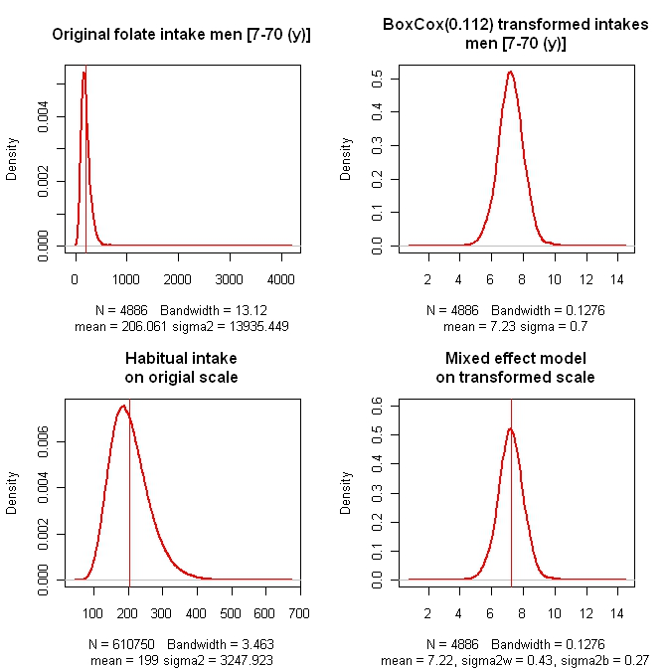

habitual intakes: main steps 1-part modelling
Transformation of intakes to obtain a symmetric distribution
Modelling σ^{2 →} $σ_{b}^{2}$+ $σ_{w}^{2}$ within & between person variance
Back-transformation to original scale
1
2
3

Slide 8
1-part model – most basic model
f.spade(frml.ia=ca ~ fp(age),
frml.if="no.if",
data=DNFCSmanual,
min.age=1,
max.age=79,
sex.label="female",
seed=29062020,
spade.output.path = “0_SPADE_output”
)
Nutrient of interest & fractional polynomial function of age
No ‘intake frequency’
Food consumption data
Min age in model
Max age in model
Gender for which habitual intake will be estimated
Seed in order to be able to reproduce your results

Slide 9
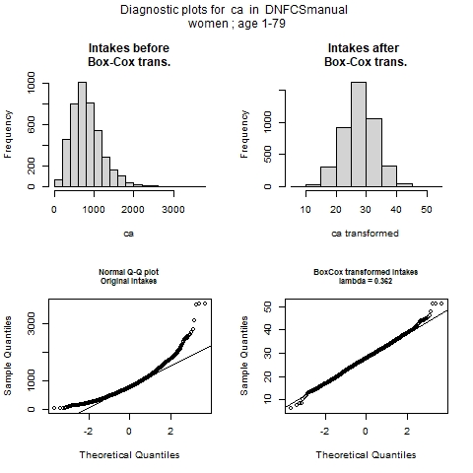
1-part model – plots - 4
The impact of the Box-Cox transformation
Left before transformation
Right after transformation
Transformed intakes are more or less
normally distributed:
QQ-plot straight line with some deviations at both ends (outliers?)

Slide 10
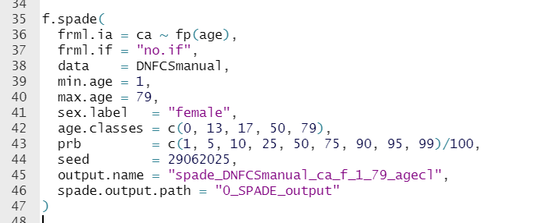
Additional options in SPADE
<- Age classes are requested
<- Specific percentiles are requested

Slide 11
Questions?

Slide 12
Programme
Wednesday July 9th
09:00-12:00 Short break around 10:45 | - Welcome back - SPADE for combined intake from food and supplements - SPADE for subgroups | Marjolein de Jong Jeroen Rodenburg Marjolein de Jong | T.007
12:00-13:00 | Lunch |  | Canteen
13:00-17:00 Short break around 15:00 | - Bootstrap for confidence intervals - Split in two groups (participants can choose): SPADE for non-daily intakes Dietary assessment - Recap - Questions & individual problems from the participants | Jeroen Rodenburg Jeroen Rodenburg Marga Ocké Lisa Tostrams Marjolein de Jong | T.007 T.019 T.007 (or vice versa) T.007
Notes:
Updaten

